Slide 1


Slide 2
The Relational Model
Getting Closer To The Real World...

Slide 3
The Relational Model
A Relation is a set of Tuples that follow a Relational Schema
Sounds fancy, but think of Tuples as rows
Think of the schema as the columns
The Domain of an attribute is the set of all possible values for that attribute
Example Relational Schema: STUDENT(Name, Ssn, Home_phone, Address, Office_phone, Age)

Slide 4
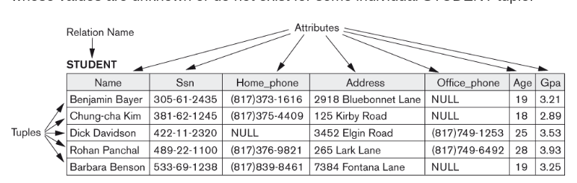
The Relational Model

Slide 5
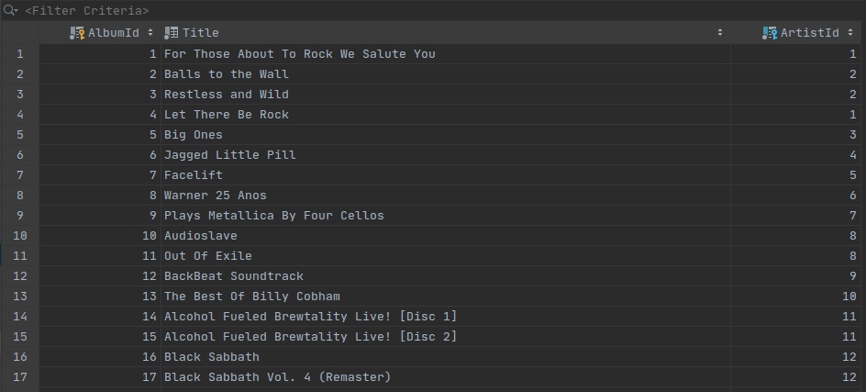
The Relational Model
Maybe easier to think of a relation as spreadsheet, but with typed & named columns, rather than free-form cells

Slide 6
NULL Values
Null values are controversial in both the relational model world as well as the programming world
Is NULL part of the domain of values?
Java primitives: no! Java objects: yes!
Most databases allow null values for a column, even if that value maps to a primitive
What to do?

Slide 7
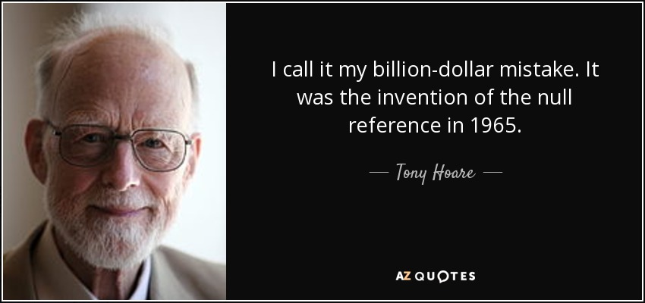
NULL Values

Slide 8
NULL Values
SELECT email FROM accounts WHERE balance > 100000
Some SQL to find the big rollers in your online casino to give them a nice, fat coupon
Don’t worry about the details right now
What about accounts with NULL for balance?
This is how you lose money with nulls :)

Slide 9
Constraints In The Relational Model
Recall that the set of constraints in the E/R diagram world was very limited
The Relational Model formalizes constraints to a much larger extent
We’ll begin by looking at keys
Super Key - any combination of attributes for which two distinct tuples will have distinct values
Minimal Super Key - A super key from which no attributes can be removed and still be a super key
Candidate Key - A minimal super key
Primary Key - The Candidate key chose as the official key for the table

Slide 10
Keys
In the real world, almost all database tables will have what is known as a synthetic key
A synthetic key is a key that is (usually) auto-generated by the DBMS for a relation when it is inserted
Very convenient
Problem: when I insert a new row in a DBMS, how do I know what the generated key was?!?
Recall UUIDs: one nice feature of them is that you can generate them “up front” without relying on the database to do it for you

Slide 11
Constraints In The Relational Model
What about references to key in another table?
A reference to another table is known as a Foreign Key
This is known as Referential Integrity
Referential Integrity Constraints are placed on a relational model (and on database tables) to ensure that Foreign Keys point to actual tuples or rows in other relations or tables

Slide 12
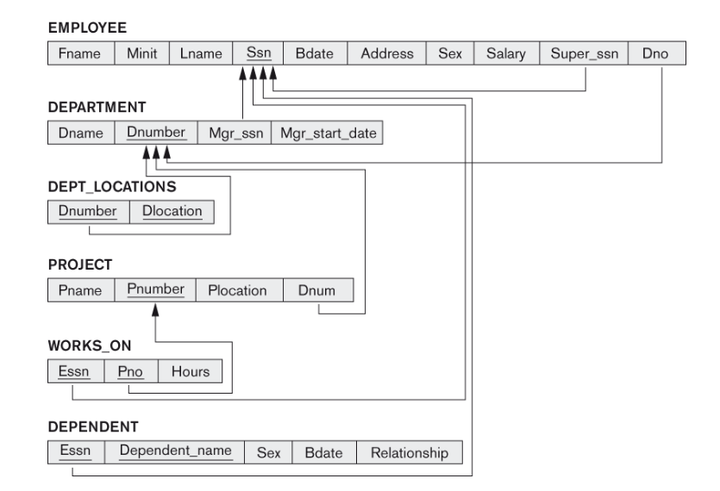
Constraints In The Relational Model

Slide 13
Constraints In The Relational Model
In DBMS systems this are often referred to as Foreign Key Constraints
In general, these are expensive
Some systems drop them to make insert performance faster
Ruby on Rails doesn’t use them
I have rarely seen an issue without them
Please don’t tell Database Administrators about this!

Slide 14
Constraints In The Relational Model
Additional Constraints
A string must be a valid email
A string must be from a set of choices (e.g. State)
AKA an enum
A column must be greater than or equal to another column
The relational model and practical databases are often not good at expressing additional constraints
These types of constraints are typically enforced at the application level
What’s the problem with this?

Slide 15
Operations on Relations
Obviously you have retrievals: reading tuples from the relation
A large part of this class is going to be teaching you to be a SELECT ninja
SELECT is the SQL way to retrieve data
You also have Update Operations
Insert
Delete
Update
Also associated with these operations is the notion of a Transaction
an atomic unit of work against the database

Slide 16
Operations on Relations
You will hear these operations referred to as CRUD
C - Create
R - Read
U - Update
D - Delete
Simple web applications are often referred to as “crud front ends on a database”
We will be building one such CRUD-dy app

Slide 17
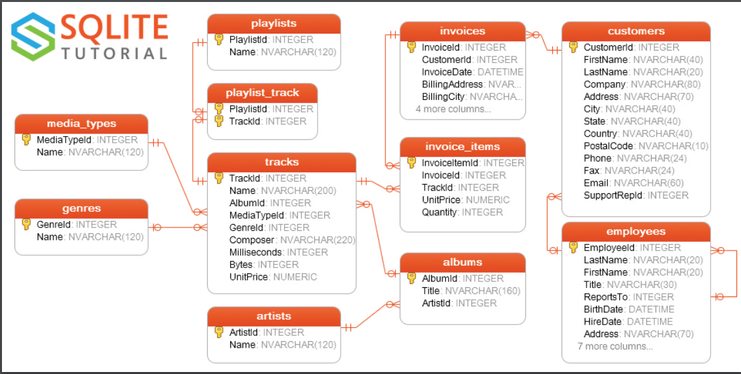
Visualizing A Relational Model
chinookdb, the sample database we will use in the class

Slide 18

The Relational Model
Notice the universality of INTEGER Ids
Note the Foreign Key references
invoices.CustomerId
This is how relationships are encoded in the tables
Notice that Employees has a self-referential key
This encodes a tree
Notes:
Can be found online… but I can’t link to it

Slide 19
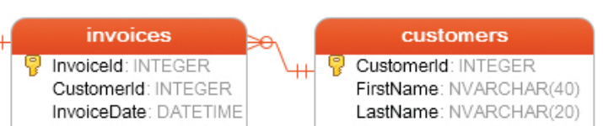
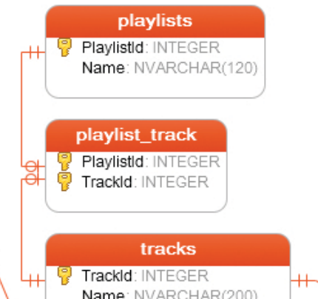
The Relational Model
1-N Relationship
FK is in N table
N-N Relationship
Done with a join table with FK of both tables
1-1 Relationship
FK can be in either table
Notes:
Can be found online… but I can’t link to it

Slide 20
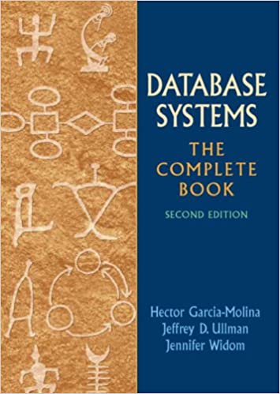
The Book
The book is not great on this topic
Dated material & overly academic language
Luckly, we have other options for learning all this stuff
Notes:
Can be found online… but I can’t link to it

Slide 21
IntelliJ DB Demo

